Slide 1
Literary Lenses: Interpreting Texts by Using Different Theoretical Approaches
Langlois

Slide 2
What is the purpose of glasses?

Slide 3
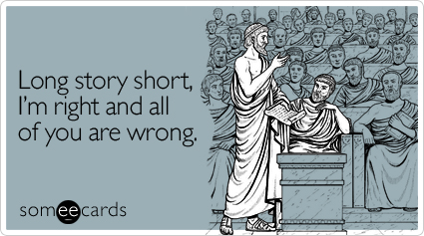
What is a Lens ?
A lens is a literary theory through which we read and understand a text.
While using your lens you always think your lens is the best approach to the text.

Slide 5
Different Lenses
Feminist

Slide 6
Feminism
https://www.youtube.com/watch?v=c9SUAcNlVQ4

Slide 7
Feminist
Strategies
Consider he gender of the author.
Consider the gender of the characters and the roles that they play in the text.
What gender stereotypes are present or subverted in the text?

Slide 8
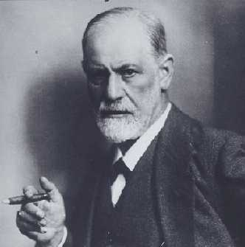
Different Lenses
Psychological

Slide 9
Psychological
https://www.youtube.com/watch?v=mQaqXK7z9LM

Slide 10
Psychological
Strategies
How does the author’s experiences or life trauma reflect his or her text?
Example: Poe writing about death because all of the woman in his life died of TB.
How might symbols in the story reflect deep seeded anxieties or desires of the character?
How might the life experiences or relationships with others explain the characters actions?

Slide 11
Marxist

Slide 12
Marxist
https://www.youtube.com/watch?v=fSQgCy_iIcc

Slide 13
Marxist
Strategies
Explore the way different groups of people are represented in text. Evaluate the level power they have in the hierarchies of the text.
What value is given to money in the text? Is it a priority? Does it signal power or social hierarchy?
What was the economic history of the text?

Slide 14
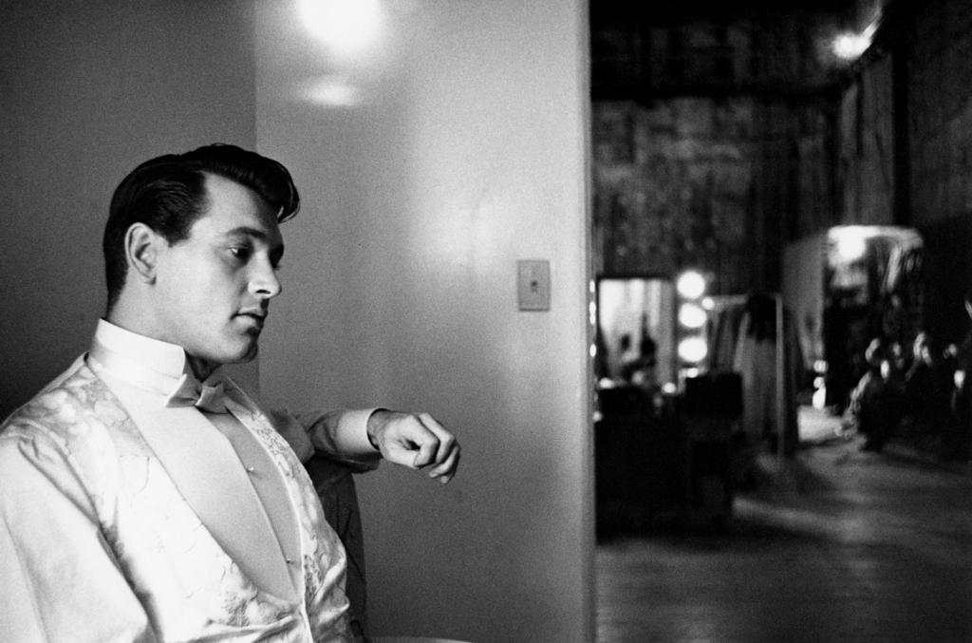
Historical

Slide 15
Historical
Strategies
Identify historical indicators within the text.
Think of the presence of historical objects within the text and their importance.
Consider how the time period in which the text was constructed might have impacted the text.

Slide 16
Activity
https://www.youtube.com/watch?v=WlV_jQrXr7c
Analyze fairy tales using different critical lenses.

Slide 17
References
Critical Encounters in High School English
By Deborah Appleman

