Slide 1
Get Out analysis
J.Langlois

Slide 2
About The Film

Slide 3
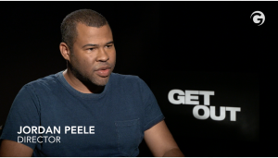
Get Out
Written and Directed by Jordan Peele
-Starring:
Daniel Kaluuya
Allison Williams
Katharine Keener
Bradly Witford
https://www.imdb.com/title/tt5052448/?ref_=fn_al_tt_1
“In many ways, the African American experience is this country’s Frankenstein monster.” Jordan Peele
https://filmschoolrejects.com/get-out-commentary-jordan-peele/amp/

Slide 4
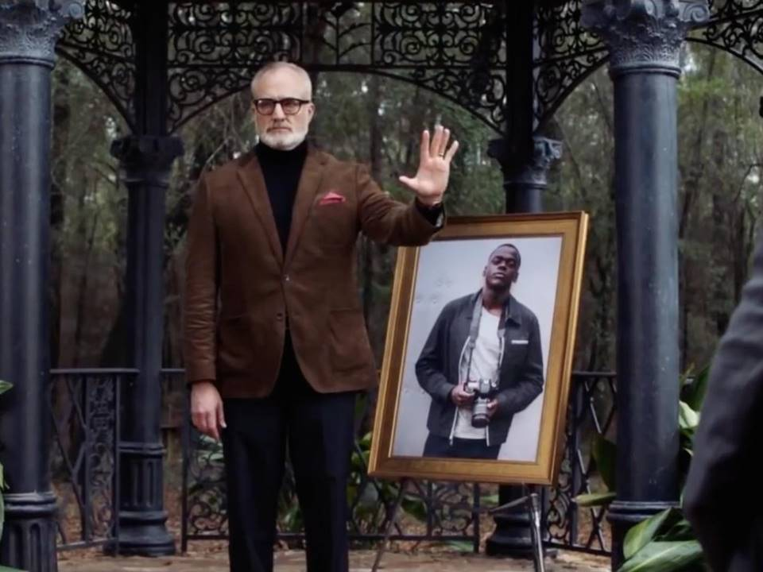
Economic History
Produced by Blum House
The Production Budget was 4.5$ Million
The worldwide gross of the film was 255$ million
https://www.boxofficemojo.com/movies/?id=blumhouse2.htm

Slide 5
Historical
- History of Black American.
-Buck
-Cotton out of chair
- “Stay Woke”
-Many References to films.
-The Shinning
-North By Northwest
-Halloween
https://filmschoolrejects.com/get-out-commentary-jordan-peele/amp/

Slide 6
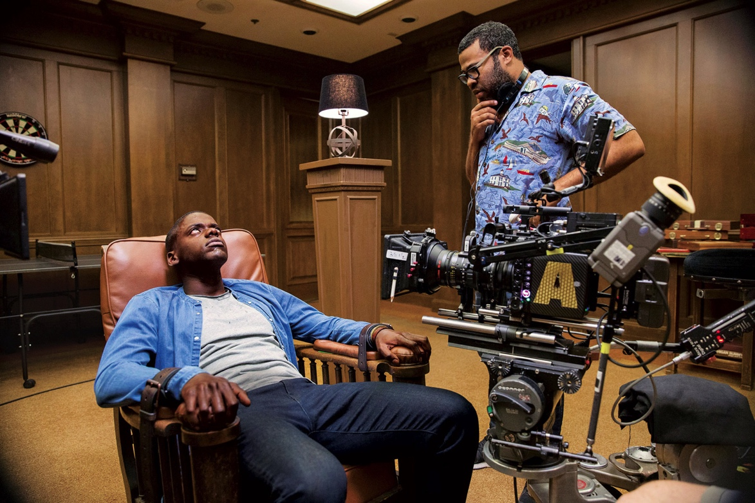
Psychological
-Trauma
-Jordan Peele is married to a white actress. Chelsea Peretti
Psychological Horror:
-Horror of psychology
Freud’s The Uncanny
-Disassociated voice
-Fast then slow

Slide 7
Marxist
White American Upper Class
Lower class is exploited
Brother
Suburbs as dangerous

Slide 8
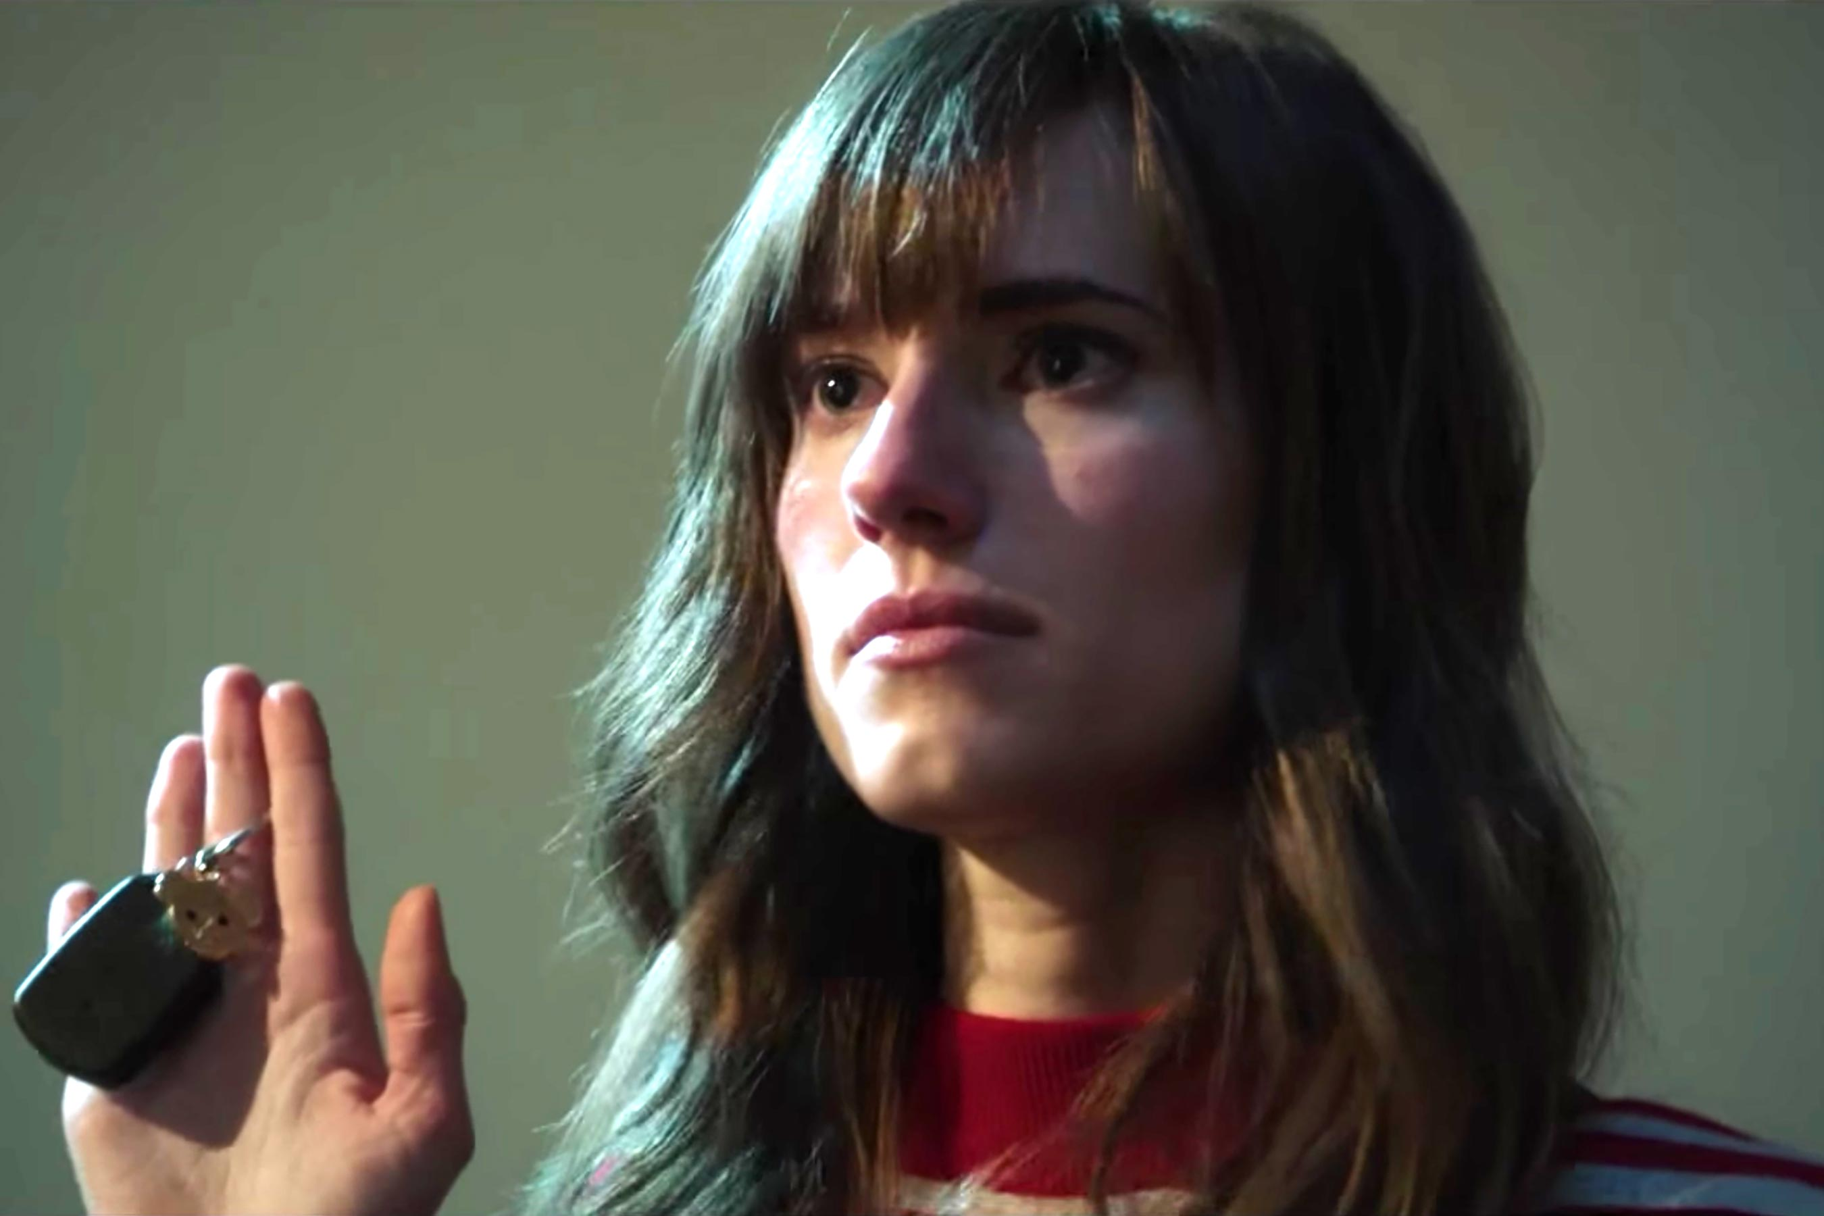
Feminist
-Villains
-Female gaze at the man

Slide 9
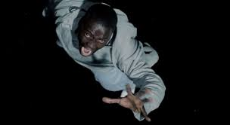
Bibliography
Hunter, Rob. "40 Things We Learned from Jordan Peele's 'Get Out' Commentary." Film School Rejects, 19 May 2017, filmschoolrejects.com/get-out-commentary-jordan-peele/amp/. Accessed 15 Oct. 2019.
https://www.boxofficemojo.com/movies/?id=blumhouse2.htm
https://www.imdb.com/title/tt5052448/?ref_=fn_al_tt_1

