Slide 1
Caine family of Low
Mr. langlois

Slide 2
Low by Rick Remender Art by Greg Tochini 2015

Slide 3
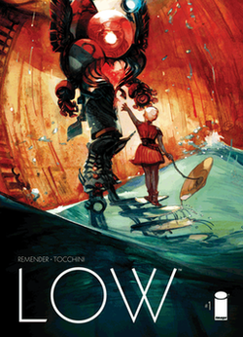
Low Plot
Takes place in the far Future.
The sun has become a red dwarf.
Humanity lives under the ocean.
Stel Caine and her family fight for hope.

Slide 4
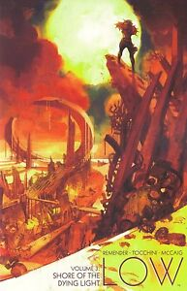
Caine family
They struggle to have hope despite of horrible things happening.
They struggle to save family.
They attempt to save the world.

Slide 5
Cultural Impact
While a well received comic it has very little impact beyond the comics themselves.
It is now coming to an end.

Slide 6
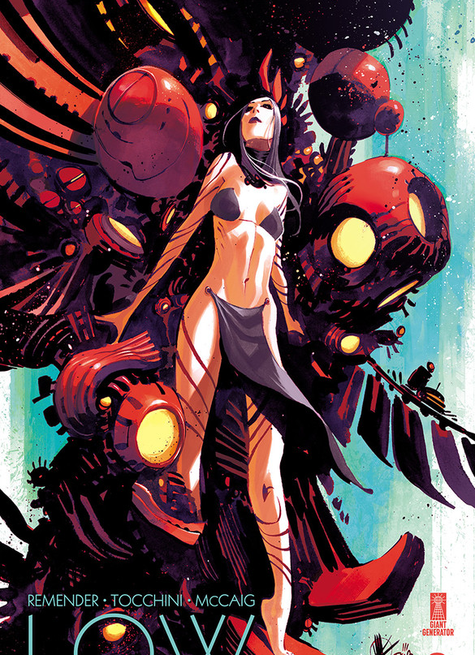
Change?
The comic has been slowly progressing over the last five years.
The characters themselves under good tremendous change.

Slide 7
Feminist Lens
Strong and impowered woman.
A little graphic in terms of content.

Slide 8
Analysis of Art

Slide 9
Allegorical Meaning
Never give up hope.
Low in every sense of the word.
The importance of family.

Slide 10
Biblogragphy
https://www.ign.com/articles/2014/01/18/rick-remender-talks-new-image-series-low
https://www.ign.com/articles/2014/07/31/low-1-review
https://bleedingcool.com/comics/low-and-outcast-from-image-comics-come-to-an-end-in-october-2020/

